Slide 1
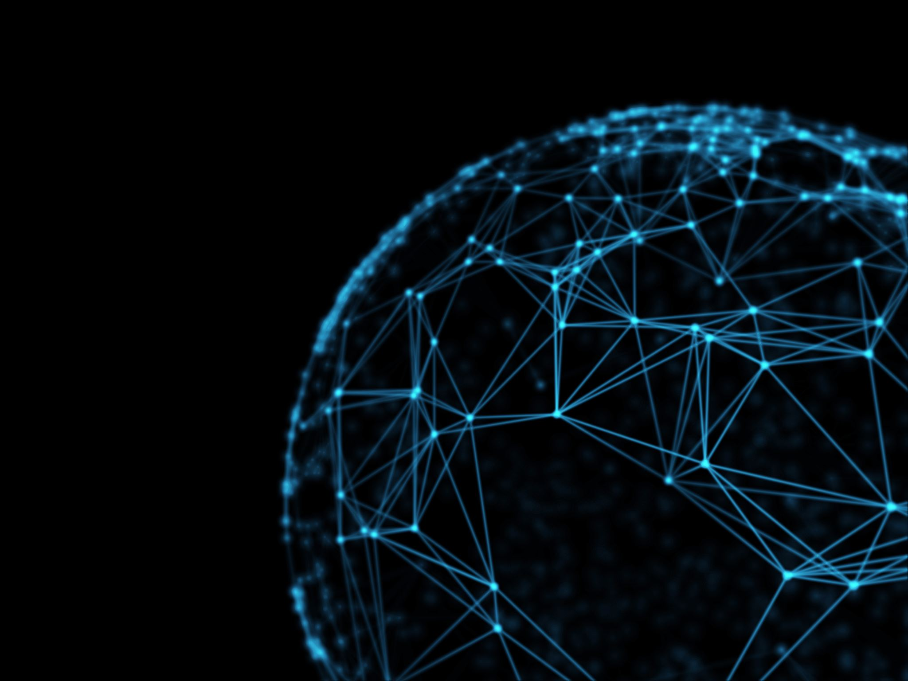
Generative Adversarial Networks

Slide 2
Content
What are Generative and Discriminant Models
What are Generative Adversarial Networks
Why do we need Generative Adversarial Networks
Architecture of Generative Adversarial Networks
Problems with Generative Adversarial Networks

Slide 3
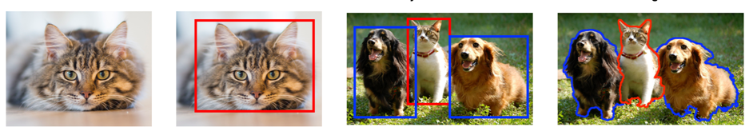
Where are we now?
Classification + Localization
Classification
Object Detection
Segmentation
CAT
CAT
CAT, DOG
CAT, DOG
Single Object
Multiple Objects
In computer vision we have used neural networks for image classification, object detection and image segmentation.
Notes:
** Till now we have been doing discriminative models. Learn boundaries between classes.

Slide 4
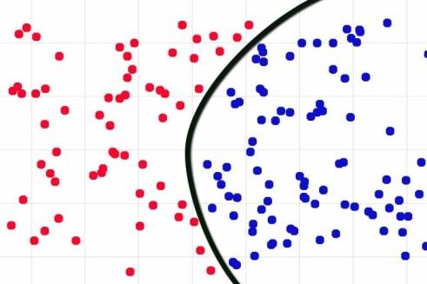
Most of the models we have been building are discriminative models which creates a decision boundary.

Slide 5
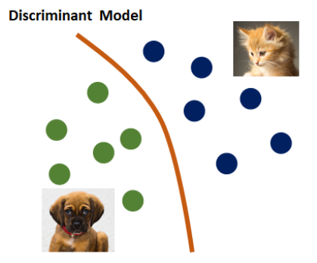
What are Discriminative Models
Directly predicts the labels based on the features.
Tries to identify the decision boundary.
For e.g: Given text of email predict whether it is spam or ham.
Algorithm: Logistic Regression, SVM, Image Classification
Discriminative Models

Slide 6
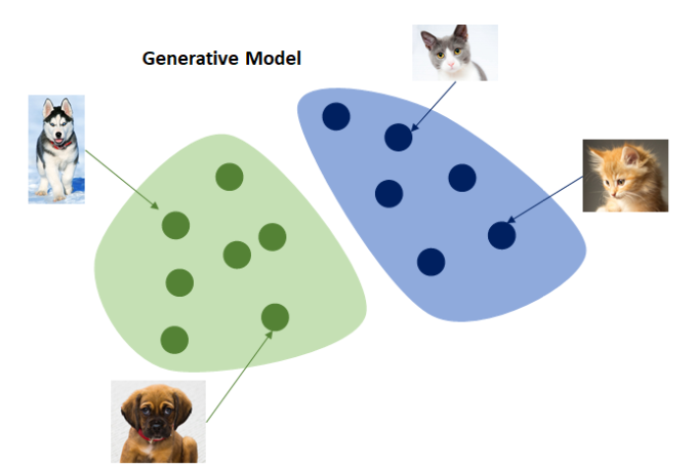
What are Generative Models
Given a label, it will try to predict the features.
Tries to understand the underlying distribution and generate new data like an image or text.
For e.g: given an email marked as spam, predict(generate) the text of the email.
Algorithm. Naïve Bayes
Notes:
Generate something new. Avoid saying probability. New image or text

Slide 7
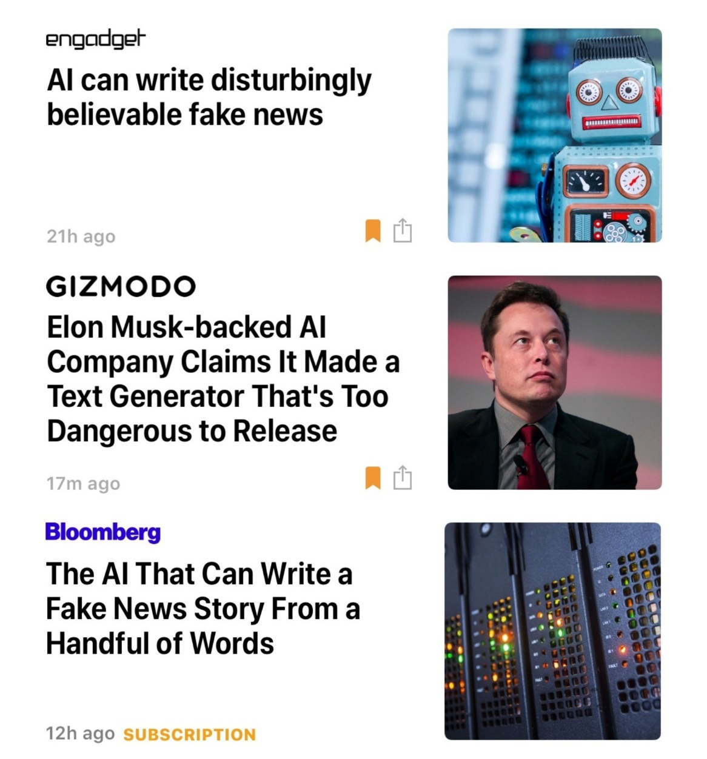
Output of Generative Models
Generative models are usually used to generate some new data like text or images.
We will look at an applications of images later.
Notes:
**Generate new stuffs

Slide 8
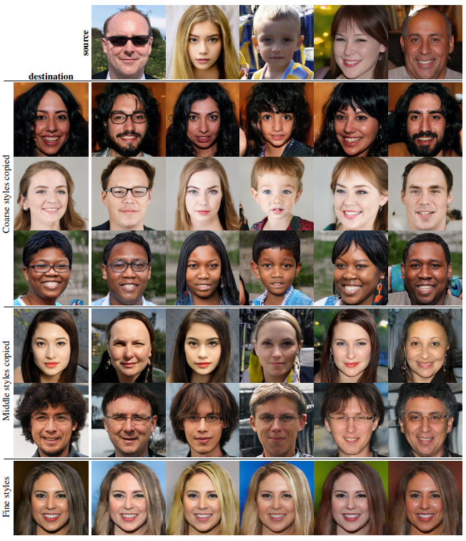
GANs – Fake face recognitionSoftware engineers from NVIDIA developed the impressive algorithm for generating realistic faces. You may have already seen it at work on
GAN – Fake Face Detection
http://www.whichfaceisreal.com/
https://thispersondoesnotexist.com/
The algorithm is trained on a ‘General Adversarial Network’ where two neural networks compete against each other; one creating fake images, the other attempting to spot the difference.
https://arxiv.org/pdf/1812.04948.pdf

Slide 9
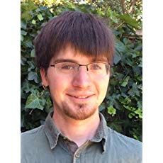
Origin of GANs
GANs were introduced in a paper by Ian Goodfellow and other researchers at University of Montreal, in 2014
Ian Goodfellow
Research Scientist, OpenAI

Slide 10
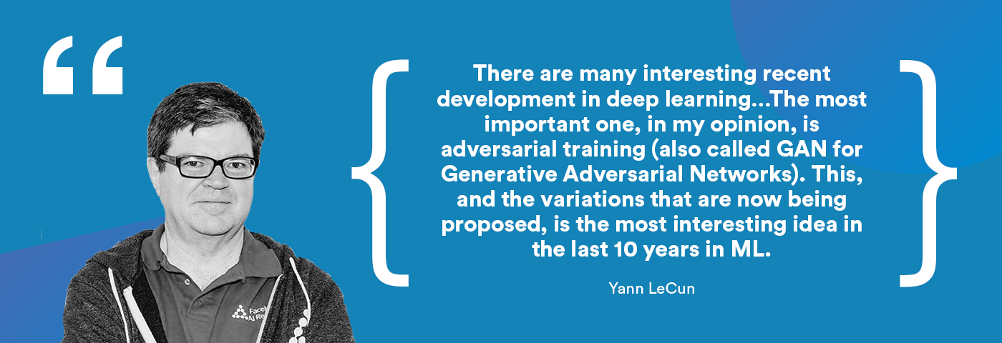
GANs: The next big idea!
Yann Lecun, Director of Facebook AI research

Slide 11
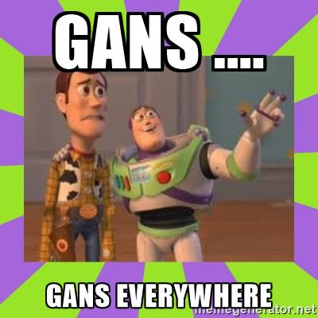
Where are GANs used?
The GANS hype ?
Since the discovery of GANs, there have been a lot of hype in AI.
But it is still in a research phase and there are not much industry applications for GANs.
Notes:
** Still at a research phase. No practical use cases.

Slide 12
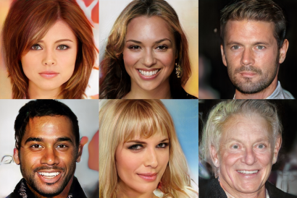
Can you identify these celebrities?
These are not real faces, instead they are computer generated images.
https://research.nvidia.com/publication/2017-10_Progressive-Growing-of

Slide 13
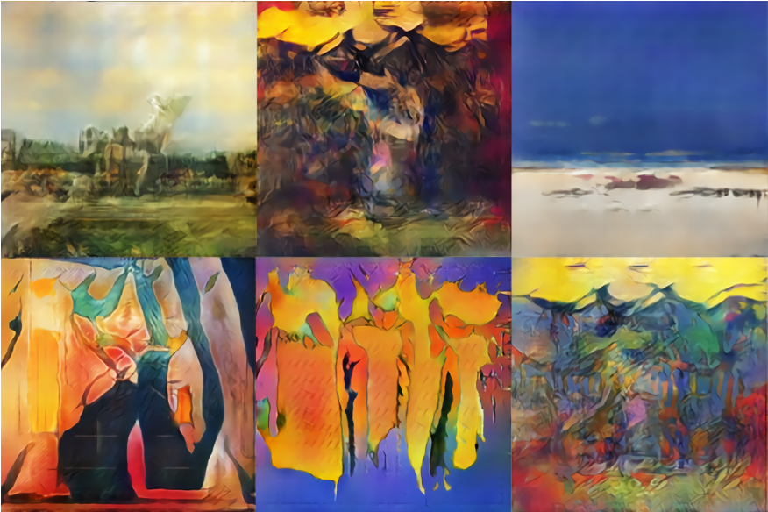
AI generated art
These paintings were generated using AI.
https://www.christies.com/features/A-collaboration-between-two-artists-one-human-one-a-machine-9332-1.aspx

Slide 14
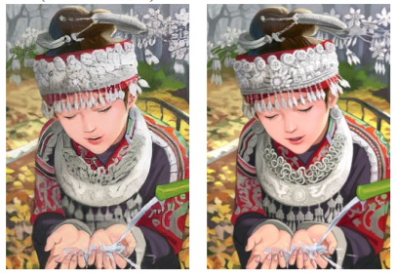
Super-Resolution
Super resolution image
Original Image
Using GANs you can convert low resolution images to high resolution images.
https://arxiv.org/pdf/1609.04802v3.pdf

Slide 15
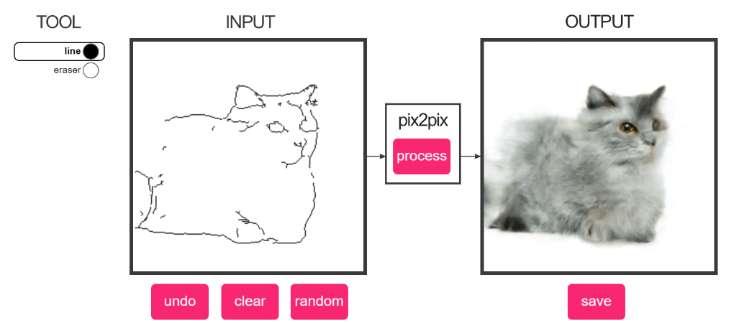
Image to Image Translation
Using a simple sketch, GANs can generate realistic images.
https://affinelayer.com/pixsrv/

Slide 16

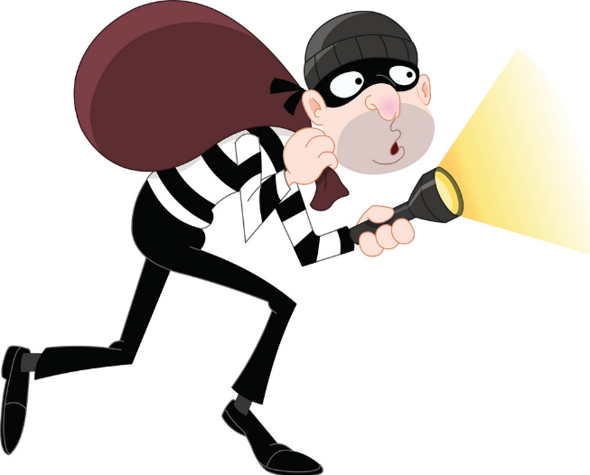
Intuition behind GANs
Fraud
Counterfeiter
(Generator)
Cop
Discriminator
GANs network is a game between counterfeiter(generator) and discriminator. The counterfeiter(fraud) tries to sell fake art as Picasso’s paintings and the discriminator(cop) is trying to detect fake paintings.

Slide 17
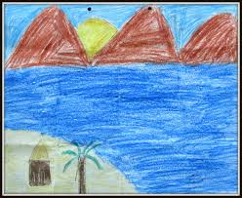
Step 1: Generator output
Counterfeiter
(Generator)
Discriminator
The fraud produces a simple art and tries to sell it as Picasso’s painting.

Slide 18
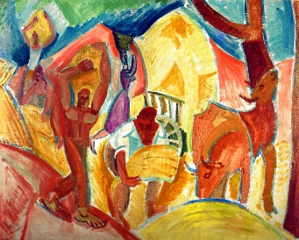
Step 2: Training Discriminator
Counterfeiter
(Generator)
Discriminator
The cop will check the fraud’s painting and compare it with an actual painting of Picasso.

Slide 19
Step 3: Discriminator Label
Probability = 0.1
This image is fake.
Counterfeiter
(Generator)
Discriminator
The cop will provide a probability value between 0 to 1 depending on whether it is True or Fake.
Now the cop is learning to identify fake images. He will also provide feedback to the fraud(generator).
Notes:
** It provides feedback to the generator

Slide 20
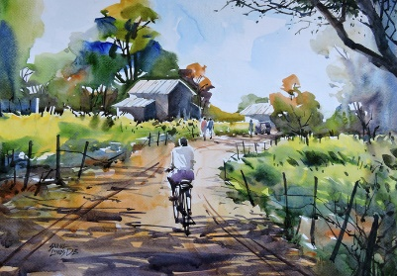
Step 4: Training Generator
I will make a better painting.
Counterfeiter
(Generator)
Discriminator
The fraud will learn from the feedback provided by the cop and try to make a better painting.

Slide 21
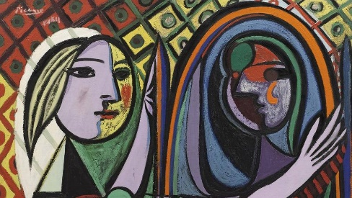
Step 5: Training GANs
Fraud
Counterfeiter
(Generator)
Cop
Discriminator
Steps 1 to 4 is continued until the fraud makes a painting as good as Picasso.

Slide 22
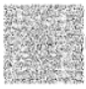
GANs architecture
Real images
Discriminator
Predicted Labels
Generator
Fake images
Noise
Notes:
** Problem of normal GANs and (Transition) why we got into DC GANS

Slide 23
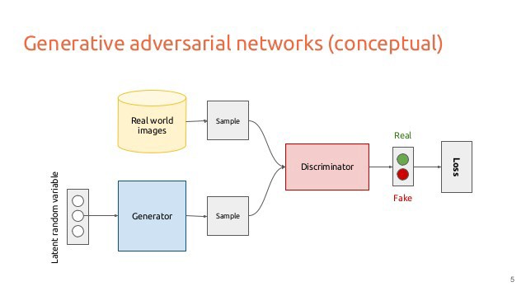

Slide 24
Issues while training GANs
While training GANs:
The training time was taking too long.
The generator may not produce naturally looking results.
This issue was resolves using DCGAN.
Notes:
** May not produce natural looking results.

Slide 25
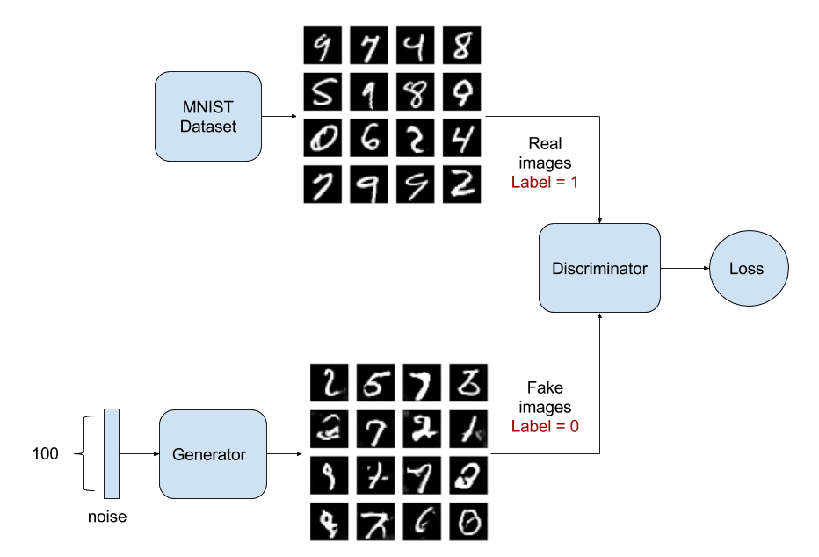
Deep Convolution GANs (DCGAN)
The core idea is to use convolutional neural networks at both Discriminator and Generator networks.
Applications: DCGANs are used to synthesize fake image.

Slide 26
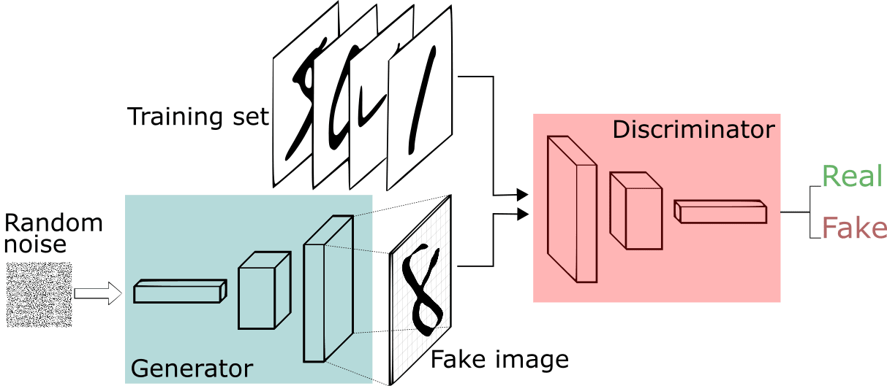
DCGANs

Slide 27
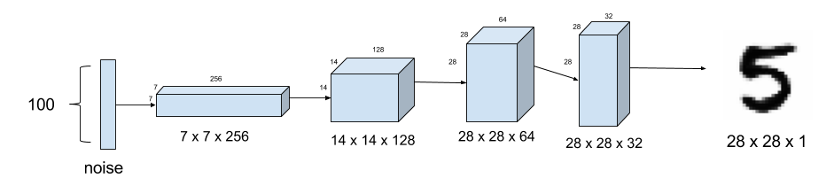
Generator of DCGAN
Generator G is a set of convolution layers with fractional-strided convolutions or Transpose convolutions so it upsamples the input image at every convolutional layer.

Slide 28
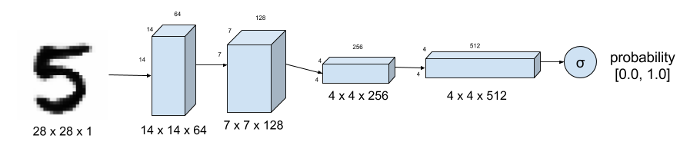
Discriminator of DCGAN
Discriminator D is a set of convolution layers with strided convolutions so it down samples the input image at every convolutional layer.
It outputs the probability of how real the image is.

Slide 29
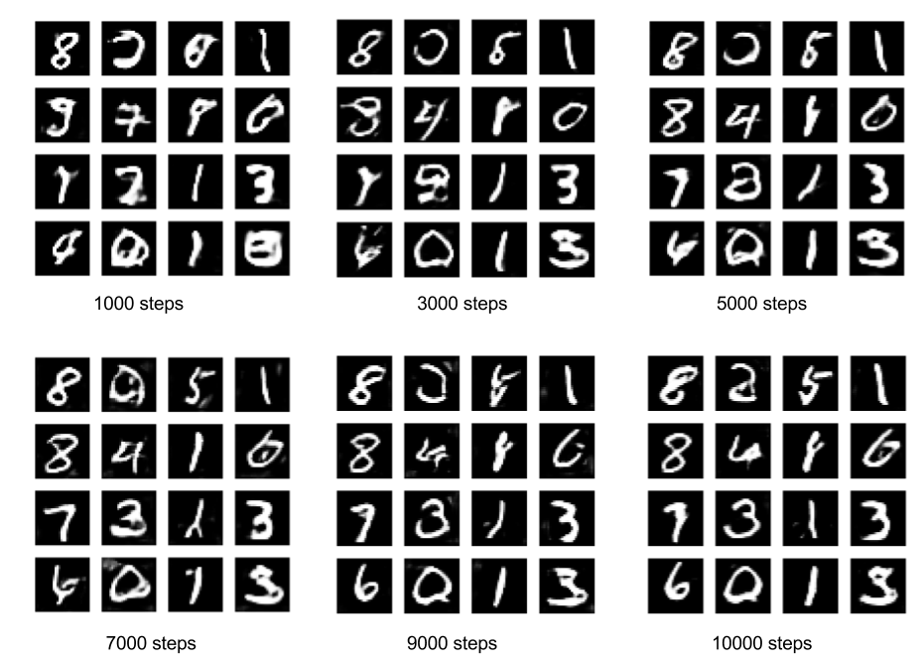
Output of DCGANs
The DCGAN will learn to generate its own hand written digits.

Slide 30
Problems with GANs: Balance between discriminator and generator
GANs are created by training two networks and it is important to keep a balance between them.
If the discriminator part is more powerful than the generator, the generator will fail to train effectively.
On the other hand if the discriminator is too weak, it will generate literally any image.
GANs take a long time to train.

Slide 31
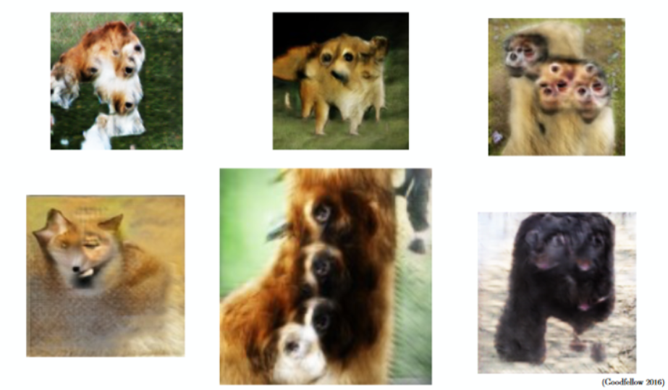
Problems with GANs: Counting
They don’t understand how many object should be present in a location.
For e.g: The dogs have more than 2 eyes and noses.
Notes:
** GANS are unstable

Slide 32
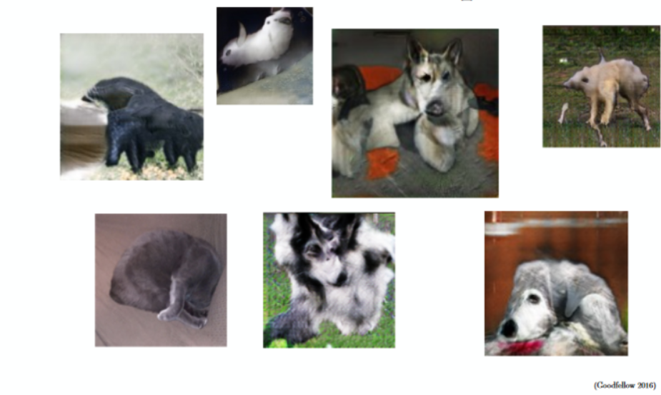
Problems with GANs: Perspective
GANs cannot understand the depth of an object i.e. they cannot differentiate between front view and back view.

